Slide 1


STATISTICS
Session 2: Descriptive Statistics

Slide 2
Descriptive Statistics
Descriptive statistics are methods used to organise, summarise and present data in a clear and informative way.
A raw dataset may contain hundreds or thousands of observations, making it difficult to identify important patterns simply by looking at the individual values. Descriptive statistics help transform these values into information that is easier to understand.
The purpose of descriptive statistics is to describe the data that have been observed. They can help us answer questions such as:
  What is a typical value?
  How much do the observations differ from one another?
  Which values or categories occur most frequently?
  Are there any unusual observations?
  What patterns or relationships are visible in the data?

Slide 3

Categorical Data – An example
Suppose we had some data on 5,000 people including information on whether:
  The individual has been diagnosed with a particular medical condition
    'Asthma’,
    'Cancer’,
    'Depression’,
    'Diabetes’,
    'Heart Disease'
    'None of Above’
  The amount of exercise they do.
    'Moderate exercise'
    'Minimal exercise’

Slide 4
Categorical Data – An example
Here is a snapshot of only 8 people in our data.
Data is arranged in a tabular format, where each row corresponds to a single person.
For example:
  Person 1 has no medical conditions and does moderate exercise
  Person 2 has heart disease and does moderate exercise
  Etc.
Person ID
Medical Condition
Amount of Exercise
1
None
Moderate
2
Heart Disease
Moderate
3
Diabetes
Moderate
4
None
Moderate
5
None
Minimal
6
None
Moderate
7
Asthma
Minimal
8
None
Moderate

Slide 5
Categorical Data – An example
When dealing with categorical data, it’s common to begin by summarising data with counts (n) and percentages (%)
Person ID
Medical Condition
Amount of Exercise
1
None
Moderate
Condition
Frequency
Percentage
2
Heart Disease
Moderate
Asthma
1
12.5%
3
Diabetes
Moderate
Diabetes
1
12.5%
Heart Disease
1
12.5%
4
None
Moderate
None
5
62.5%
5
None
Minimal
6
None
Moderate
Exercise
Frequency
Percentage
7
Asthma
Minimal
Minimal
2
25%
Moderate
6
75%
8
None
Moderate

Slide 6
Categorical Data – An example
But we can also look at the variables as pairs (i.e. both at the same time). This is referred to as a contingency table or a cross tabulation.
Person ID
Medical Condition
Amount of Exercise
1
None
Moderate
2
Heart Disease
Moderate
Exercise
3
Diabetes
Moderate
Condition
Minimal
Moderate
Total
Asthma
1
0
1
4
None
Moderate
Diabetes
0
1
1
5
None
Minimal
Heart Disease
0
1
1
None
1
4
5
6
None
Moderate
Total
2
6
8
7
Asthma
Minimal
8
None
Moderate

Slide 7
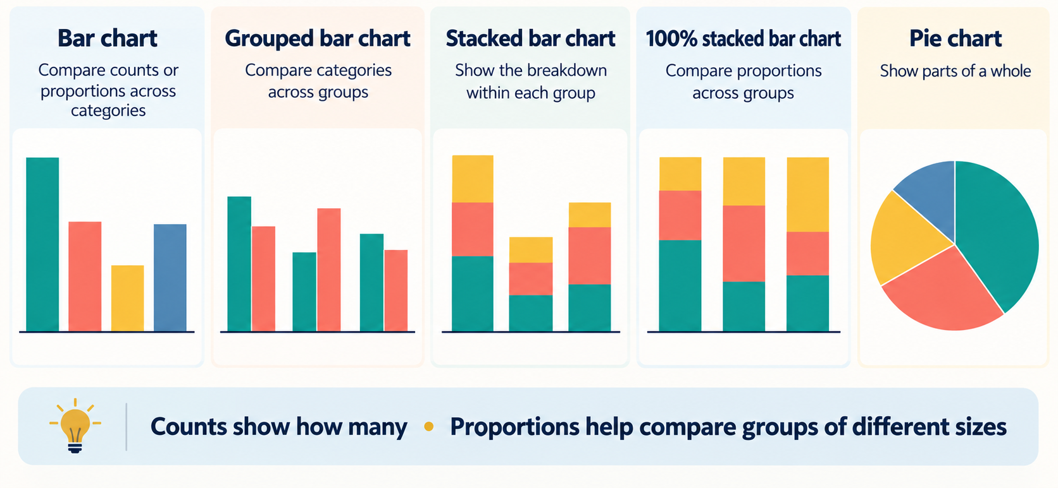
Visualising Categorical Data

Slide 8
Contingency Table and Probabilities
Row Labels | Minimal | Moderate | Total
Asthma | 260 | 166 | 426
Cancer | 256 | 125 | 381
Depression | 323 | 170 | 493
Diabetes | 146 | 56 | 202
Heart Disease | 220 | 43 | 263
None of Above | 2011 | 1224 | 3235
Total | 3216 | 1784 | 5000
Divide by Row Totals
Divide by Grand Total
Divide by Column Totals
Row Labels | Minimal | Moderate | Row Total
Asthma | 0.6103 | 0.3897 | 1
Cancer | 0.6719 | 0.3281 | 1
Depression | 0.6552 | 0.3448 | 1
Diabetes | 0.7228 | 0.2772 | 1
Heart Disease | 0.8365 | 0.1635 | 1
None of Above | 0.6216 | 0.3784 | 1
Row Total | 0.6432 | 0.3568 | 1
Row Labels | Minimal | Moderate | Grand Total
Asthma | 0.0520 | 0.0332 | 0.0852
Cancer | 0.0512 | 0.0250 | 0.0762
Depression | 0.0646 | 0.0340 | 0.0986
Diabetes | 0.0292 | 0.0112 | 0.0404
Heart Disease | 0.0440 | 0.0086 | 0.0526
None of Above | 0.4022 | 0.2448 | 0.6470
Grand Total | 0.6432 | 0.3568 | 1
Row Labels | Minimal | Moderate | Column Total
Asthma | 0.0808 | 0.0930 | 0.0852
Cancer | 0.0796 | 0.0701 | 0.0762
Depression | 0.1004 | 0.0953 | 0.0986
Diabetes | 0.0454 | 0.0314 | 0.0404
Heart Disease | 0.0684 | 0.0241 | 0.0526
None of Above | 0.6253 | 0.6861 | 0.6470
Column Total | 1 | 1 | 1

Slide 9
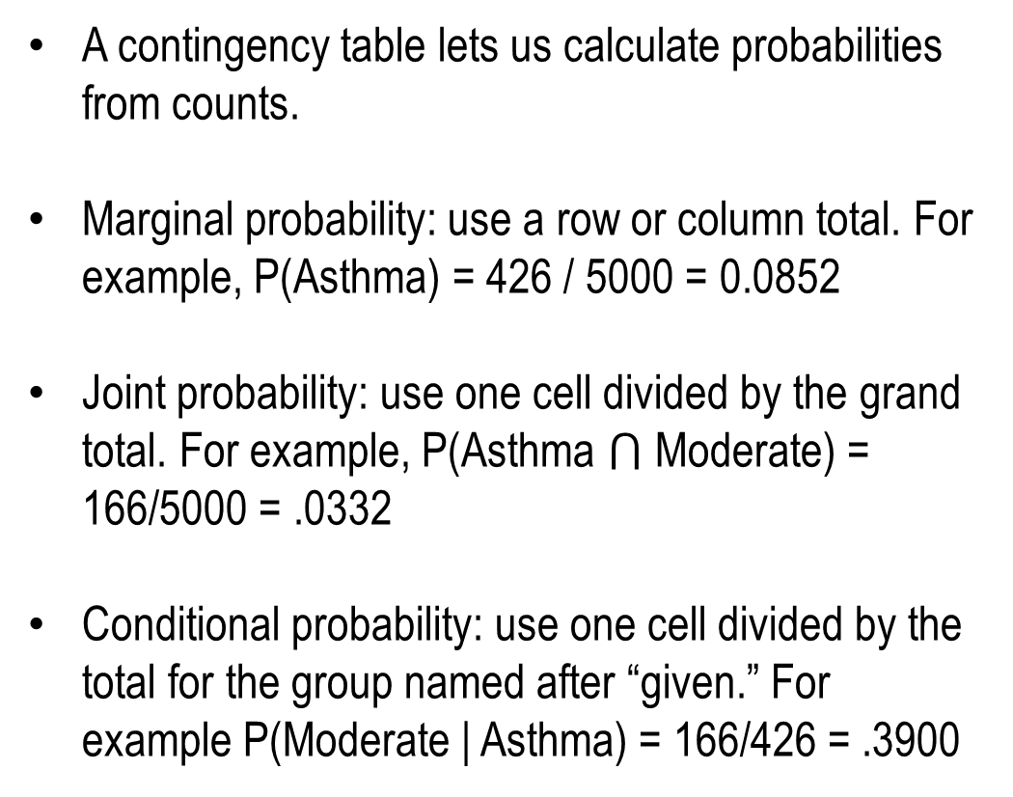
Contingency Table and Probabilities
A contingency table lets us calculate probabilities from counts.
Marginal probability: use a row or column total. For example, P(Asthma) = 426 / 5000 = 0.0852
Joint probability: use one cell divided by the grand total. For example, P(Asthma $⋂$ Moderate) = 166/5000 = .0332
Conditional probability: use one cell divided by the total for the group named after “given.” For example P(Moderate | Asthma) = 166/426 = .3900
Row Labels | Minimal | Moderate | Total
Asthma | 260 | 166 | 426
Cancer | 256 | 125 | 381
Depression | 323 | 170 | 493
Diabetes | 146 | 56 | 202
Heart Disease | 220 | 43 | 263
None of Above | 2011 | 1224 | 3235
Total | 3216 | 1784 | 5000

Slide 10



Independence (Method 1)
Two events are independent if the probability of one event occurring is unaffected by the outcome of the other event
Row Labels | Minimal | Moderate | Total
Asthma | 260 | 166 | 426
Cancer | 256 | 125 | 381
Depression | 323 | 170 | 493
Diabetes | 146 | 56 | 202
Heart Disease | 220 | 43 | 263
None of Above | 2011 | 1224 | 3235
Total | 3216 | 1784 | 5000
Divide by Column Totals
$$\operatorname{Pr}\left(Diabetes\right)=0.0404$$
Row Labels | Minimal | Moderate | Column Total
Asthma | 0.0808 | 0.0930 | 0.0852
Cancer | 0.0796 | 0.0701 | 0.0762
Depression | 0.1004 | 0.0953 | 0.0986
Diabetes | 0.0454 | 0.0314 | 0.0404
Heart Disease | 0.0684 | 0.0241 | 0.0526
None of Above | 0.6253 | 0.6861 | 0.6470
Column Total | 1 | 1 | 1
$$\operatorname{Pr}\left(Diabetes|Minimal\right)=0.0454$$
$$\operatorname{Pr}\left(Diabetes|Moderate\right)=0.0314$$
$$\operatorname{Pr}\left(Diabetes|Minimal\right)≠\operatorname{Pr}\left(Diabetes|Moderate\right)≠\operatorname{Pr}\left(Diabetes\right)$$

Slide 11
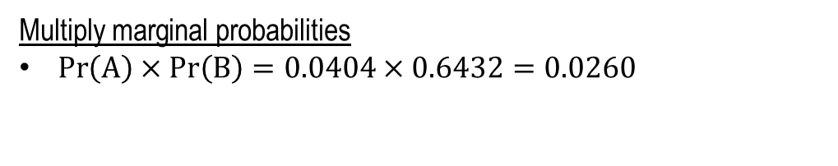

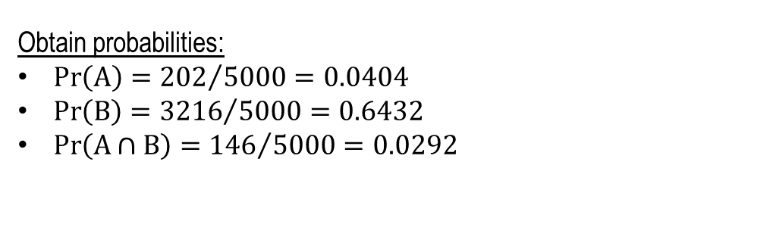



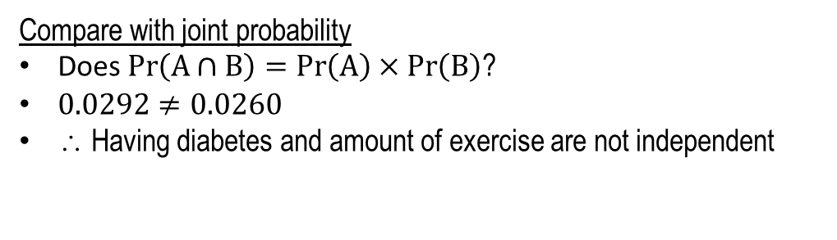
Independence (Method 2)
Row Labels | Minimal | Moderate | Total
Asthma | 260 | 166 | 426
Cancer | 256 | 125 | 381
Depression | 323 | 170 | 493
Diabetes | 146 | 56 | 202
Heart Disease | 220 | 43 | 263
None of Above | 2011 | 1224 | 3235
Total | 3216 | 1784 | 5000
Define:
A: Person has Diabetes
B: Person does Minimal exercise
Obtain probabilities:
$\operatorname{Pr}\left(A\right)={202}/{5000=0.0404}$
$\operatorname{Pr}\left(B\right)={3216}/{5000=0.6432}$
$\operatorname{Pr}\left(A∩B\right)={146}/{5000=0.0292}$
$$\operatorname{Pr}\left(A∩B\right)=$$
$$\operatorname{Pr}\left(A\right)$$
$$×$$
$$\operatorname{Pr}\left(B\right)$$
Multiply marginal probabilities
$\operatorname{Pr}\left(A\right)×Pr\left(B\right)=0.0404×0.6432=0.0260$
Compare with joint probability
Does $\operatorname{Pr}\left(A∩B\right)=\operatorname{Pr}\left(A\right)×\operatorname{Pr}\left(B\right)$?
$0.0292≠0.0260$
∴ Having diabetes and amount of exercise are not independent

Slide 12
Numerical Data
When describing numerical data, we typically describe the centre and spread of the data
  Centre: describes where the values tend to cluster: what is a typical value. Common examples include:
    The mean (or average): sum of all values divided by the number of values
    The median: the middle value when the data is ordered
    The mode: the value that occurs most often in the dataset.
  Spread: describes how much the values differ from one another. Common examples include:
    The range: maximum minus the minimum
    The interquartile range: 75th percentile – 25th percentile
    The variance: measures how spread out the values are by averaging their squared deviations from the mean.
    The standard deviation: is the square root of the variance. It describes the spread of values around the mean in the same units as the data.

Slide 13
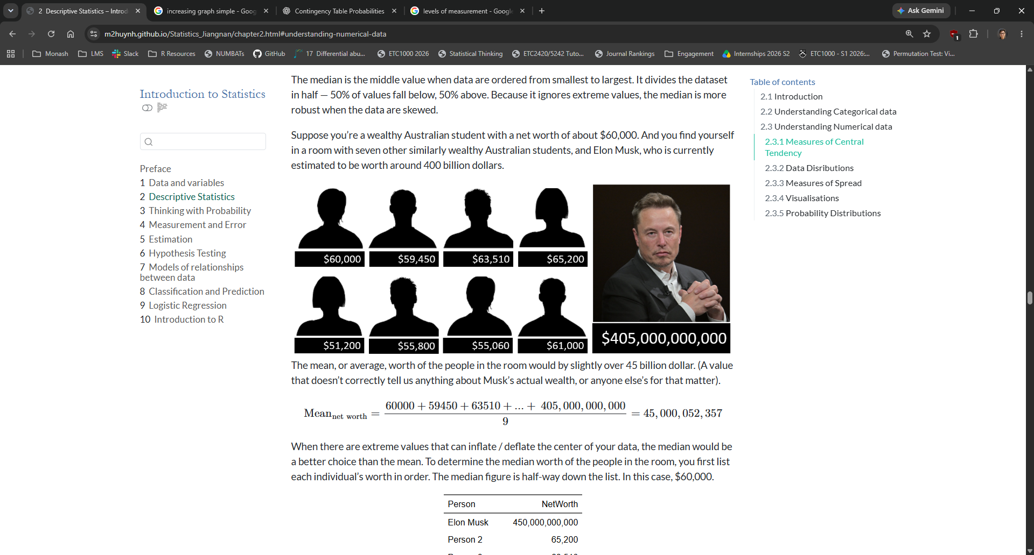



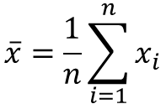

Measures of Centre: The Mean
$$\overline{x}=\frac{1}{n}\sum_{i=1}^{n}{x_{i}}$$
$$=\frac{x_{1}+x_{2}+…+x_{n}}{n}$$
$$=\frac{60,000+59,450+…+61,000}{8}$$
$=58902.5$ (this is an appropriate ‘typical’ value for these 8)
The mean is sensitive to outliers. In this example, the mean would be:
$$\frac{60,000+59,450+…+405,000,000,000}{9}$$
$$=45,000,052,357$$
This would not tell us what the ‘typical’ net worth of any of these 9 people

Slide 14








Measures of Centre: The Median
Odd number
Even number
Elon Musk
$405,000,000,000
Elon Musk
$405,000,000,000
Person 2
$65,200
Person 2
$65,200
Person 3
$63,510
Person 3
$63,510
Person 4
$61,000
Person 4
$61,000
Person 5
$60,000
Person 5
$60,000
Person 6
$59,450
Person 6
$59,450
Person 7
$55,800
Person 7
$55,800
Person 8
$55,060
Person 8
$55,060
Person 9
$51,200
Person 9
$51,200
$$Median={\left(\frac{n+1}{2}\right)}^{th}$$
Person 10
$50,500
$$Median=\frac{{\left(n/2\right)}^{th}+{\left(n/2+1\right)}^{th}}{2}$$
$$Median={\left(\frac{9+1}{2}\right)}^{th}$$
$$Median=\frac{5^{th}+6^{th}}{2}$$
$$Median=5^{th}$$
$$Median=\$60,000$$
$$Median=\frac{60,000+59,450}{2}$$
$$Median=\$59,725$$

Slide 15
Measures of Centre: The Mode
Participant ID | Years of Tertiary Education
1 | 0
2 | 0
3 | 0
4 | 1
5 | 1
6 | 2
7 | 3
8 | 3
9 | 3
10 | 3
11 | 3
12 | 3
13 | 4
14 | 4
15 | 7
16 | 7
17 | 10
Participant ID | Social Economic Status
1 | Low
2 | Low
3 | Low
4 | Low
5 | Medium
6 | Medium
7 | Medium
8 | Medium
9 | Medium
10 | Medium
11 | Medium
12 | Medium
13 | Medium
14 | Medium
15 | High
16 | High
17 | High

Slide 16
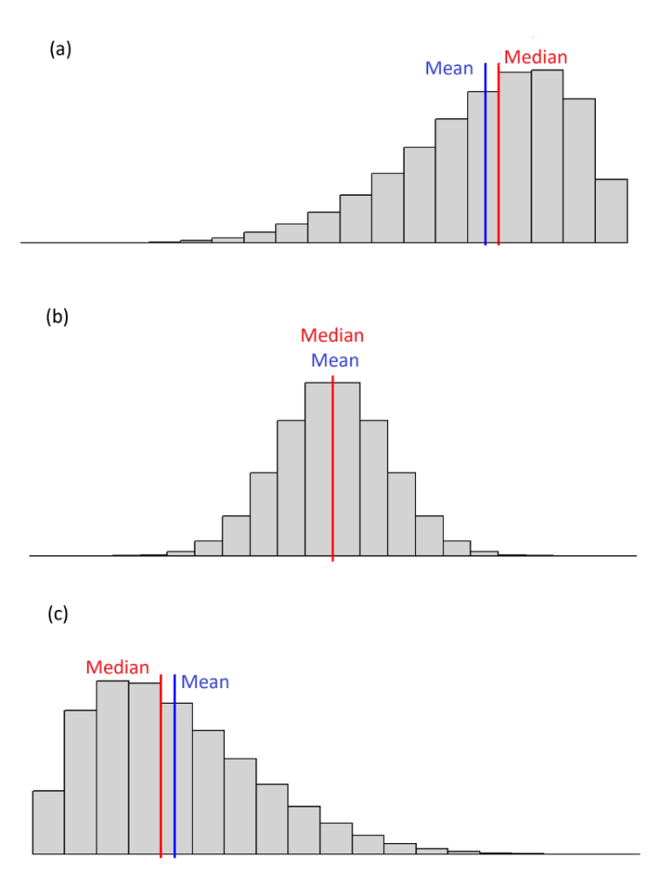
Describing Data Distributions
When the mean is lower than the median, the data generally displays negative skewness. This is often due to a few small values in the left tail of the distribution.
When the mean is approximately equal to the median, the data displays a symmetrical distribution. There is approximately equal number of small and large values the decrease in frequency from the center of the data.
When the mean is larger than the Median, the data generally displays positive skewness. This is often due to a few large values in the right tail of the distribution.

Slide 17
Measures of Spread: The Range
Description: The simplest measure of spread: the distance between the smallest and largest values. It uses only two data points, so a single outlier can change it dramatically.
Equation: Range = max − min, where max is the largest observation and min is the smallest.
Example:
  Quiz scores: 2, 4, 5, 6, 8, 9, 10 and 12, so
  the range is 12 − 2 = 10 marks.
Quiz scores (out of 12), n = 8
Range = 12 − 2 = 10
0
2
4
6
8
10
12
14
Only the two orange values (min and max) affect the range; the other six dots are ignored.

Slide 18
Measures of Spread: The Interquartile Range
Description: The spread of the middle 50% of the data, measured between the first and third quartiles. Because it ignores the extreme values, it is resistant to outliers.
Equation: IQR = Q3 − Q1, where Q1 is the 25th percentile (median of the lower half) and Q3 is the 75th percentile (median of the upper half).
Example:
  Quiz scores: 2, 4, 5, 6, 8, 9, 10 and 12
    Q1 = (4 + 5) / 2 = 4.5 and
    Q3 = (9 + 10) / 2 = 9.5, so
    IQR = 9.5 − 4.5 = 5 marks.
Quiz scores (out of 12), n = 8
Q1
4.5
Median
7
Q3
9.5
0
2
4
6
8
10
12
14
IQR = 9.5 − 4.5 = 5

Slide 19
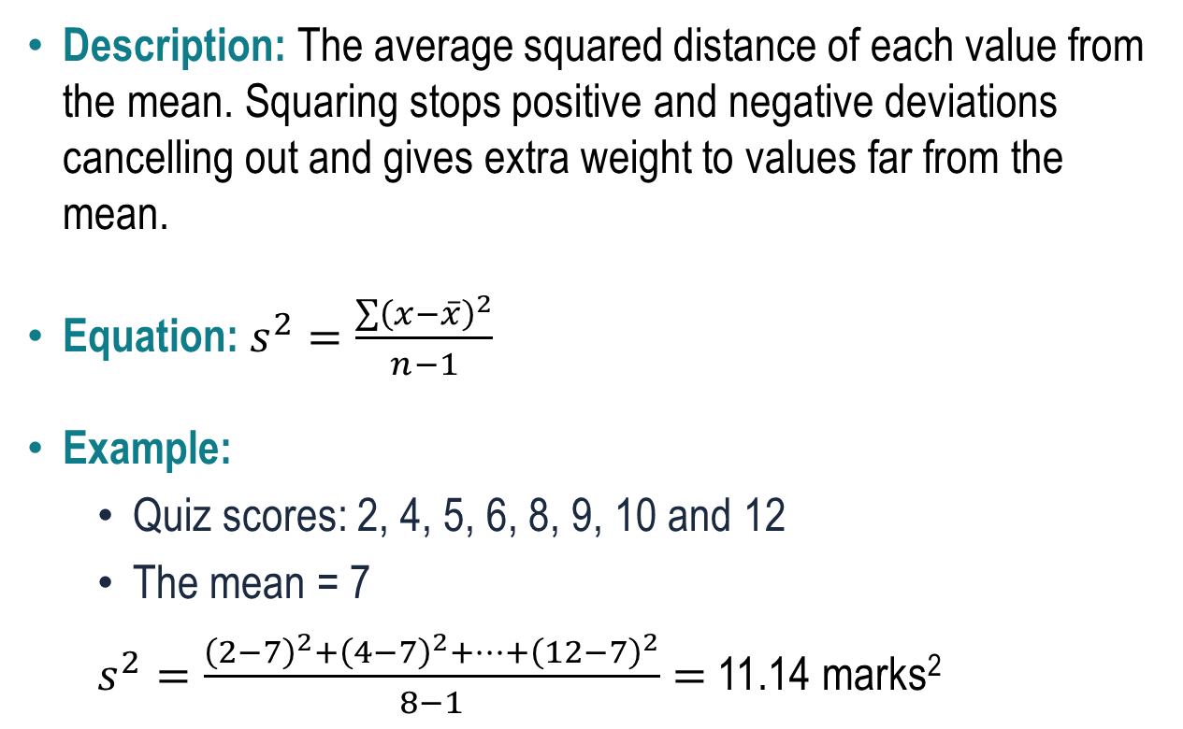
Measures of Spread: The Variance
Description: The average squared distance of each value from the mean. Squaring stops positive and negative deviations cancelling out and gives extra weight to values far from the mean.
Equation: $s^{2}=\frac{\sum{{\left(x−\overline{x}\right)}^{2}}}{n−1}$
Example:
  Quiz scores: 2, 4, 5, 6, 8, 9, 10 and 12
  The mean = 7
  $s^{2}=\frac{{\left(2−7\right)}^{2}+{\left(4−7\right)}^{2}+…+{\left(12−7\right)}^{2}}{8−1}=$ 11.14 marks²
Quiz score by student (out of 12)
+5
12
+3
+2
+1
8
mean
= 7
−1
4
−2
−3
−5
0
1
2
3
4
5
6
7
8
Each orange line is a deviation from the mean. Variance averages their squares.

Slide 20
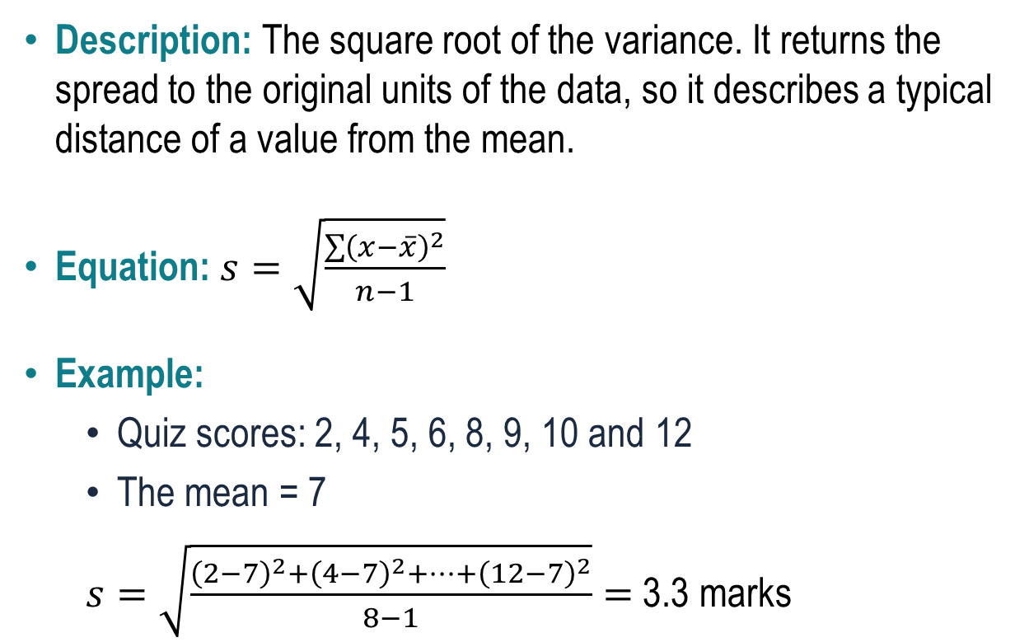
Measures of Spread: The Standard Deviation
Description: The square root of the variance. It returns the spread to the original units of the data, so it describes a typical distance of a value from the mean.
Equation: $s=\sqrt{\frac{\sum{{\left(x−\overline{x}\right)}^{2}}}{n−1}}$
Example:
  Quiz scores: 2, 4, 5, 6, 8, 9, 10 and 12
  The mean = 7
  $s=\sqrt{\frac{{\left(2−7\right)}^{2}+{\left(4−7\right)}^{2}+…+{\left(12−7\right)}^{2}}{8−1}}=$ 3.3 marks
Quiz score by student (out of 12)
12
mean + s
≈ 10.3
8
mean
= 7
4
mean − s
≈ 3.7
0
1
2
3
4
5
6
7
8
The shaded band is one SD either side of the mean; 6 of 8 scores fall inside it.

Slide 21
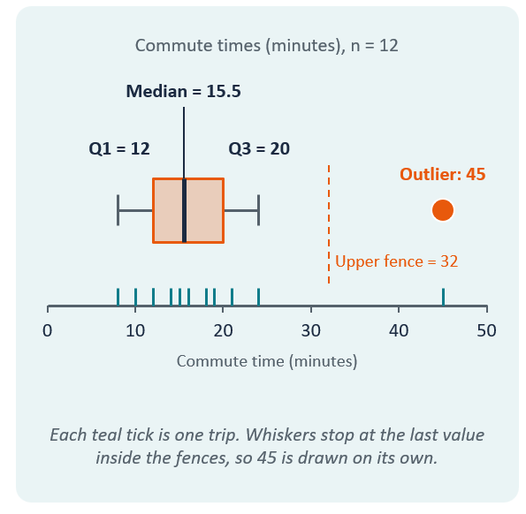
Visualising Numerical Data: Boxplots
Description: A boxplot summarises the distribution using five numbers: minimum, Q1, median, Q3 and maximum. The box holds the middle 50% of the data, and points far from the box are flagged as outliers.
Rule: Fences = Q1 − 1.5 × IQR and Q3 + 1.5 × IQR. Whiskers extend to the most extreme values inside the fences; anything beyond them is plotted as a separate point.
Example: Twelve commute times (minutes) give Q1 = 12, median = 15.5 and Q3 = 20, so IQR = 8 and the fences are 0 and 32. The 45-minute trip is an outlier, and the whiskers end at 8 and 24.

Slide 22
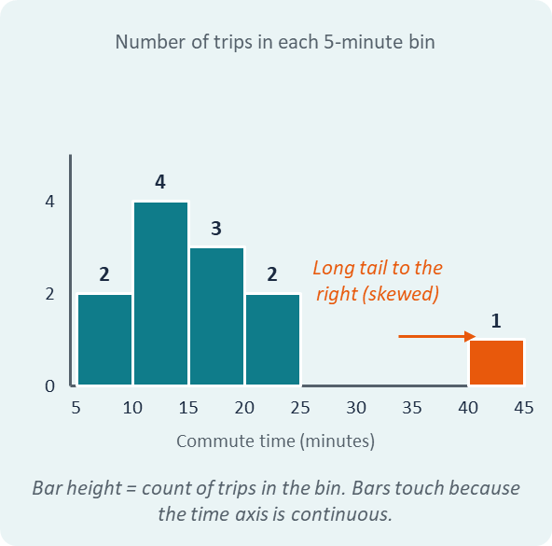
Visualising Numerical Data: Histogram
Description: A histogram splits numerical data into equal-width bins and draws a bar for each one. The bar height is the count of values in that bin, so the shape shows the centre, spread and skewness.
Example: The same commute times with bins (from the boxplot) of width 5 give counts of 2, 4, 3, 2, 0, 0, 0 and 1. The data are right-skewed, with the 45-minute trip alone in the far-right bin.

Slide 23
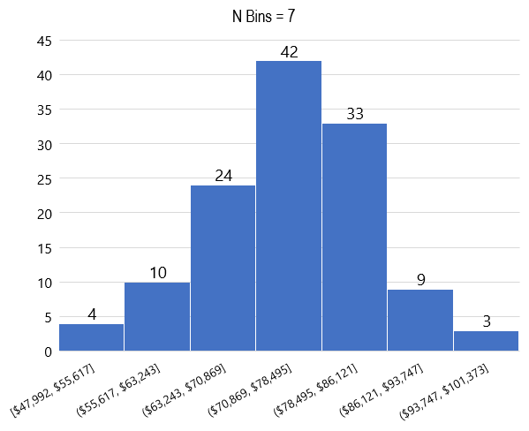
Histograms and Probability Distributions
Income Range | Frequency | Probability
[$47992, $55617] | 4 | 0.032
($55617, $63243] | 10 | 0.080
($63243, $70869] | 24 | 0.192
($70869, $78495] | 42 | 0.336
($78495, $86121] | 33 | 0.264
($86121, $93747] | 9 | 0.072
($93747, $101373] | 3 | 0.024

Slide 24
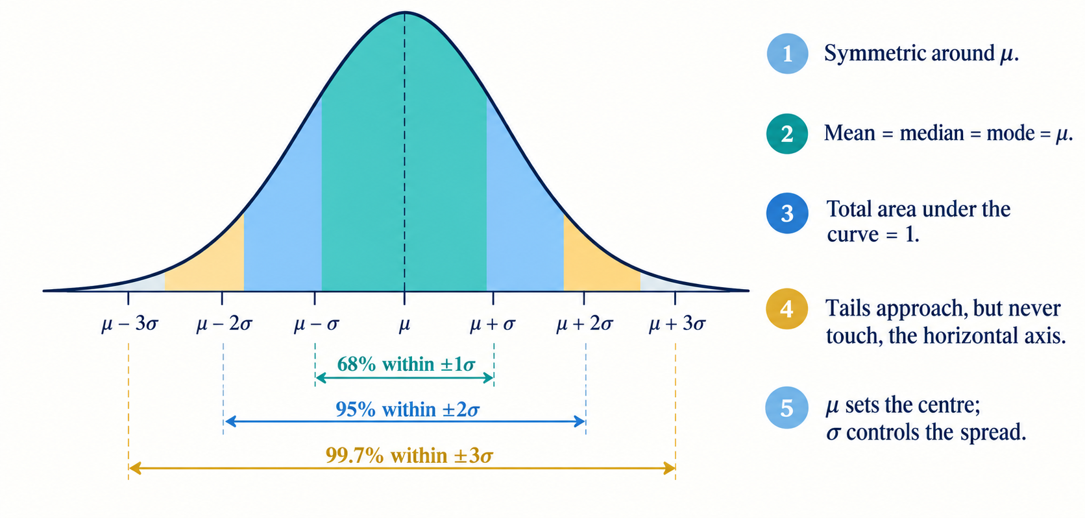
Properties of the Normal Distribution

Slide 25
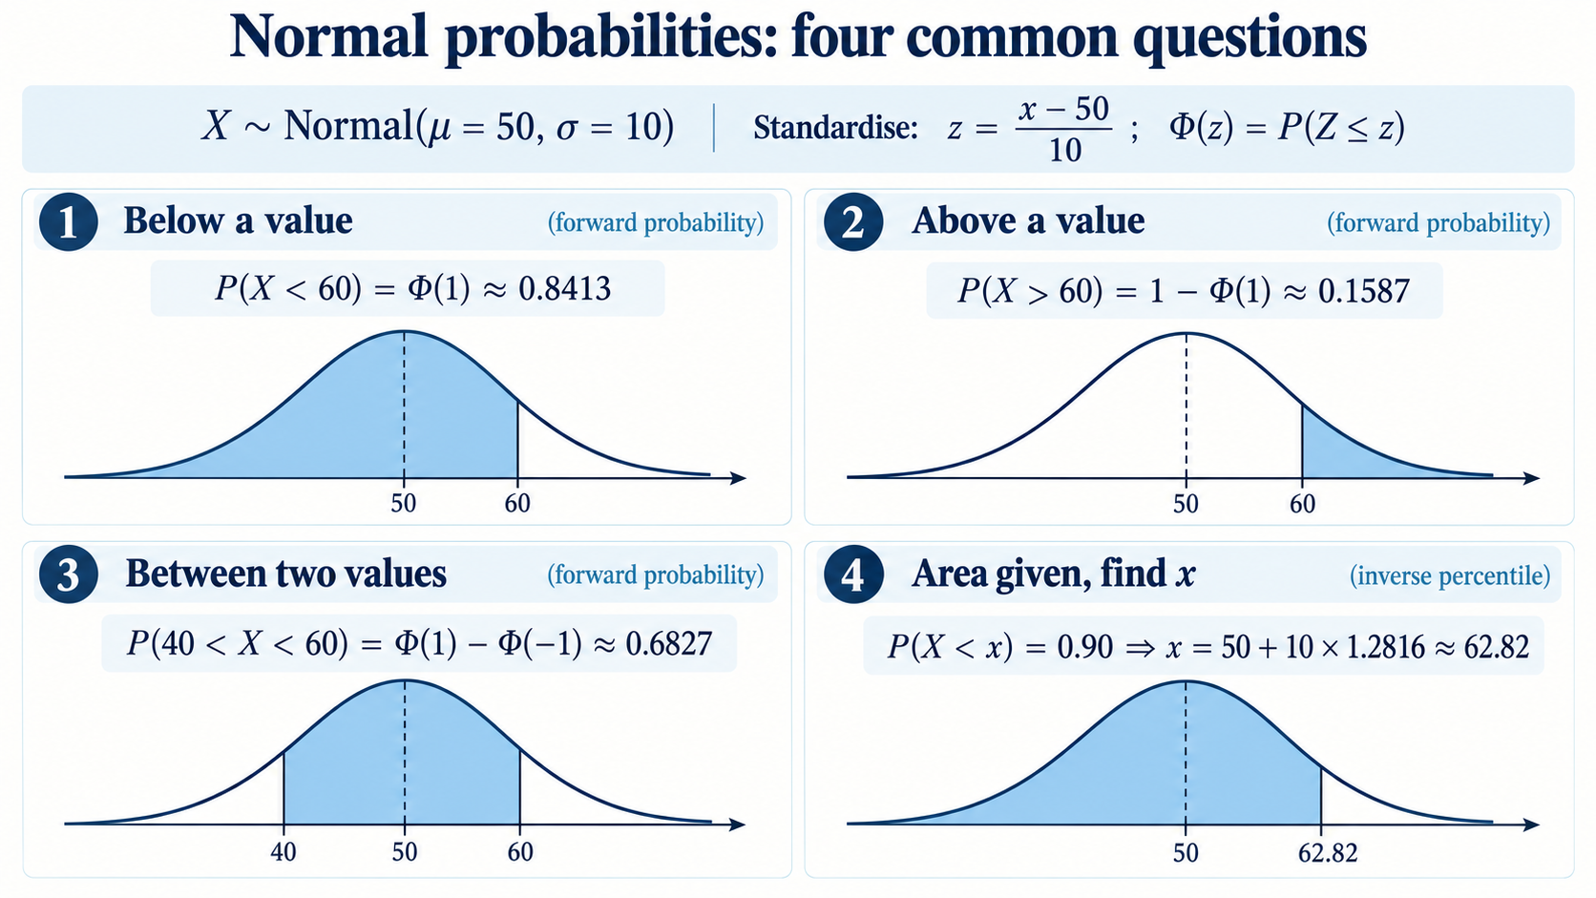
Common Probability Questions for the Standard Normal Distribution

